Slide 1

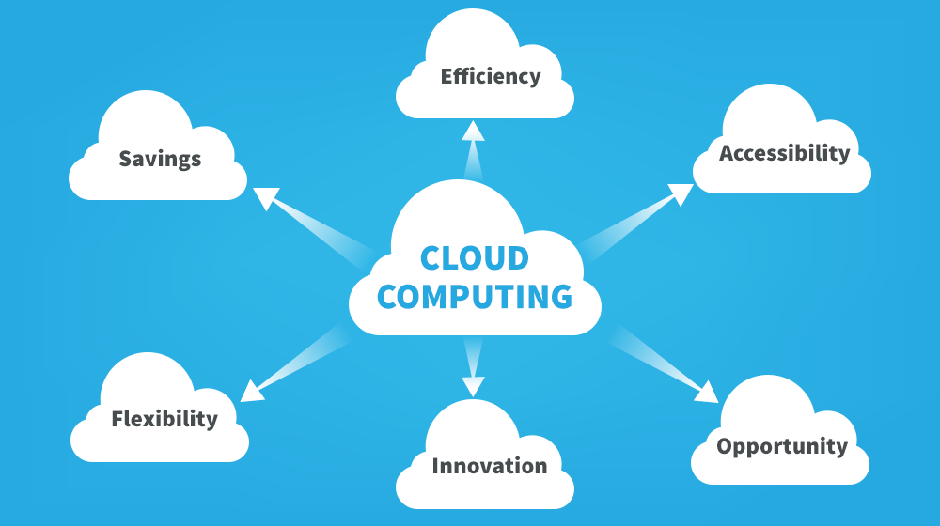
By
Ankammarao
Cse dept

Slide 2
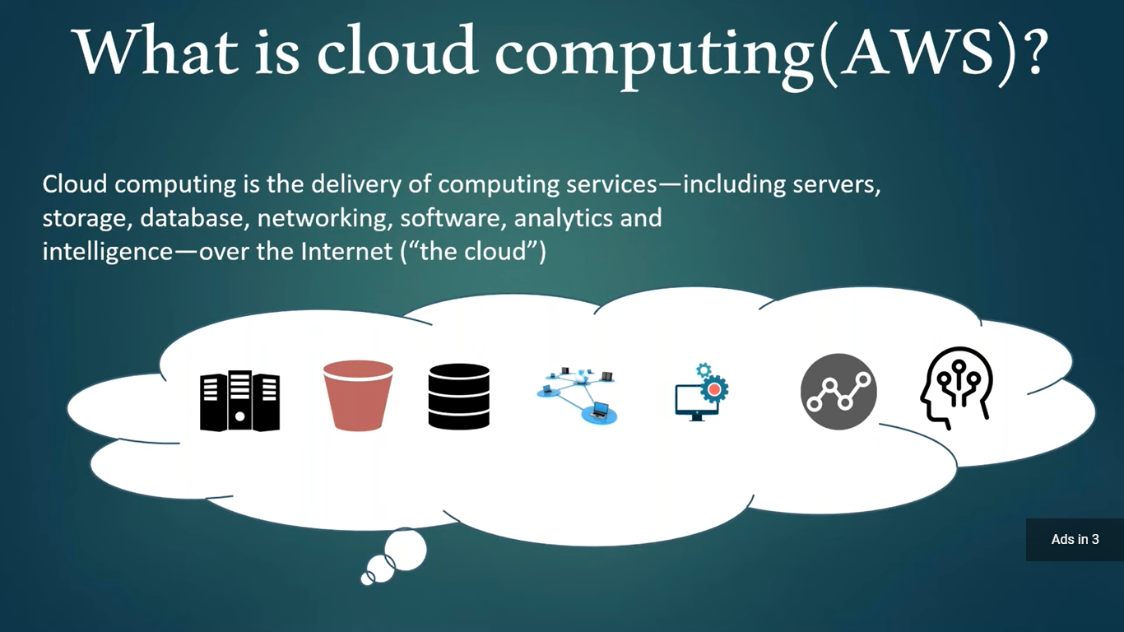
Your best quote that reflects your approach… “It’s one small step for man, one giant leap for mankind.”
- Neil Armstrong

Slide 3
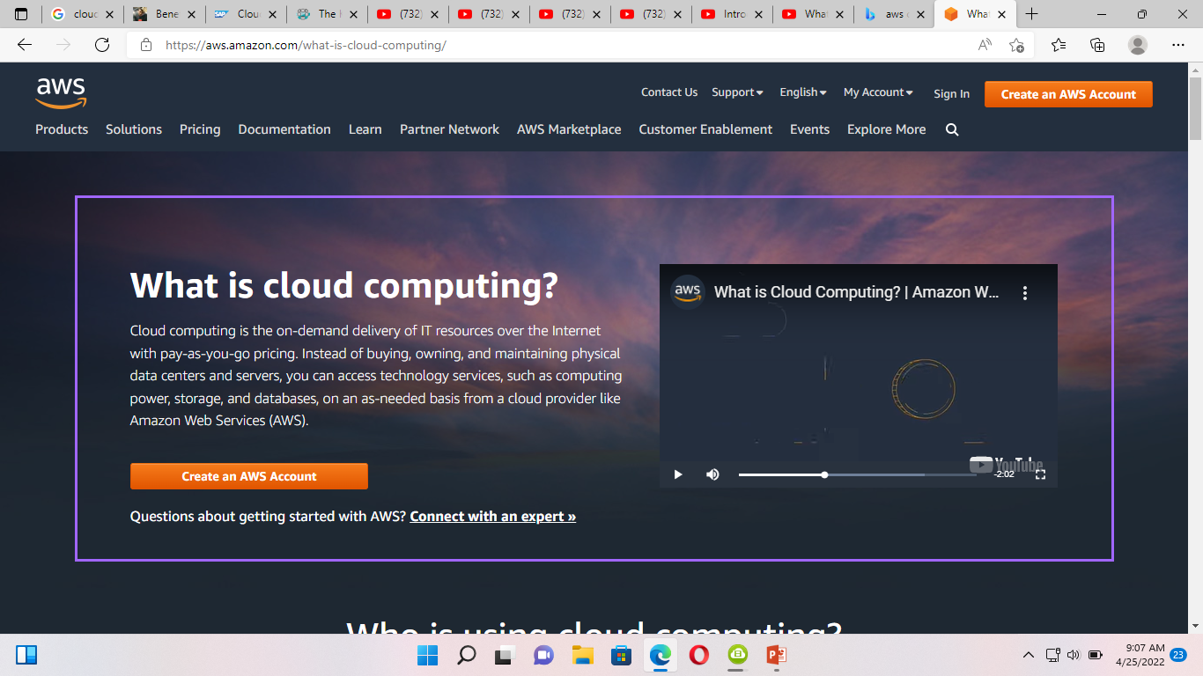

Slide 4
Cloud computing is a virtualization-based technology that allows us to create, configure, and customize applications via an internet connection. The cloud technology includes a development platform, hard disk, software application, and database.
What is Cloud Computing
The term cloud refers to a network or the internet. It is a technology that uses remote servers on the internet to store, manage, and access data online rather than local drives. The data can be anything such as files, images, documents, audio, video, and more.

Slide 5
There are the following operations that we can do using cloud computing:
Developing new applications and services
Storage, back up, and recovery of data
Hosting blogs and websites
Delivery of software on demand
Analysis of data
Streaming videos and audios

Slide 6
Why Cloud Computing?
Small as well as large IT companies, follow the traditional methods to provide the IT infrastructure. That means for any IT company, we need a Server Room that is the basic need of IT companies.
In that server room, there should be a database server, mail server, networking, firewalls, routers, modem, switches, QPS (Query Per Second means how much queries or load will be handled by the server), configurable system, high net speed, and the maintenance engineers.
To establish such IT infrastructure, we need to spend lots of money. To overcome all these problems and to reduce the IT infrastructure cost, Cloud Computing comes into existence.

Slide 7
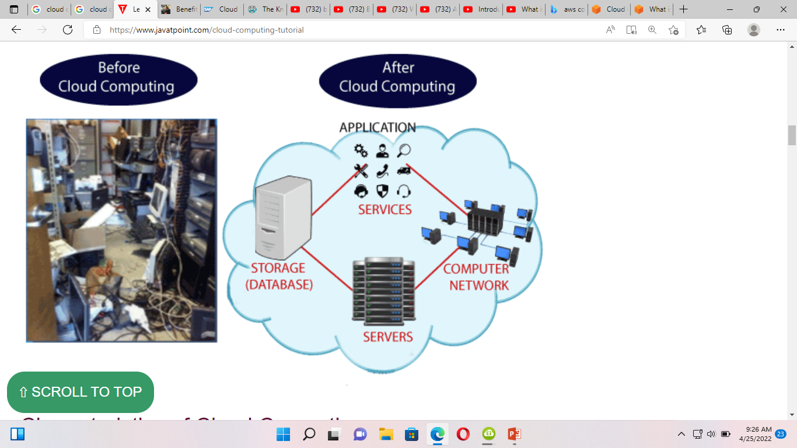

Slide 8
Characteristics of Cloud Computing
The characteristics of cloud computing are given below:
1) Agility
The cloud works in a distributed computing environment. It shares resources among users and works very fast.
2) High availability and reliability
The availability of servers is high and more reliable because the chances of infrastructure failure are minimum.
3) High Scalability
Cloud offers "on-demand" provisioning of resources on a large scale, without having engineers for peak loads.
4) Multi-Sharing
With the help of cloud computing, multiple users and applications can work more efficiently with cost reductions by sharing common infrastructure.

Slide 9
5) Device and Location Independence
Cloud computing enables the users to access systems using a web browser regardless of their location or what device they use e.g. PC, mobile phone, etc. As infrastructure is off-site (typically provided by a third-party) and accessed via the Internet, users can connect from anywhere.
6) Maintenance
Maintenance of cloud computing applications is easier, since they do not need to be installed on each user's computer and can be accessed from different places. So, it reduces the cost also
7) Low Cost
By using cloud computing, the cost will be reduced because to take the services of cloud computing, IT company need not to set its own infrastructure and pay-as-per usage of resources.
8) Services in the pay-per-use mode
Application Programming Interfaces (APIs) are provided to the users so that they can access services on the cloud by using these APIs and pay the charges as per the usage of services.

Slide 10
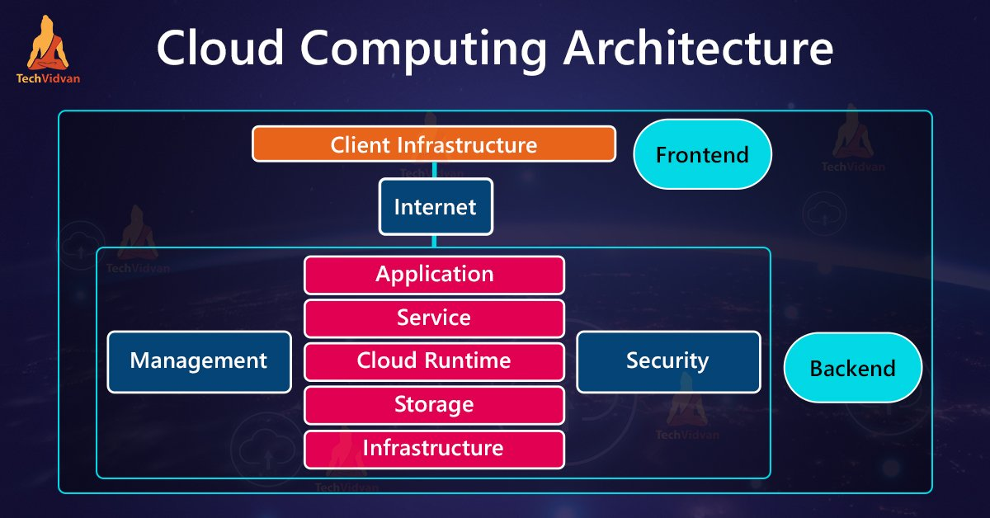

Slide 11
Cloud Computing Architecture
Cloud Computing Architecture is a mixture of Service Oriented Architecture (SOA) and Event-Driven Architecture (EDA). The modules of Cloud Computing Architecture are mentioned below and they are as follows: 1. Client Infrastructure 2. Application Service 3. Runtime 4. Storage 5. Infrastructure 6. Management 7. Security
The Cloud Computing Architecture is categorized into two main aspects such as:
Front End
Back End

Slide 12
Front End
Front End is mainly used by the client-side. It contains the interfaces which are essential for accessing the platforms of cloud computing. The front End involves the web browser, which is used by web servers, for example, Google Chrome, Mozilla Firefox, Internet Explorer and others. It also has thin and fat clients, followed by tablets and mobile devices. Cloud Infrastructure is build with hardware and software components, For example, Data Storage, Server, Virtualization Software, etc.
Back End
Back End has the complete responsibility of monitoring all the programs responsible for running the applications on the Front End. It is mainly used by the service provider. It has to manage all the resources which are necessary for providing Cloud Computing Services. Back End involves massive amounts of data storage, security operations, virtual machines, servers, and many more.
Application
Application in the Back End of Cloud Architecture refers to a platform or the software on which the client has access. In simple words, it will provide the service in the backend according to the client’s requirements.

Slide 13
Service
Back End refers to three types of cloud services such as Infrastructure-as-a-Service (IaaS), Platform-as-a-Service (PaaS), and Software-as-a-Service (SaaS). Service also has the role of managing the class of service the user accesses.
Cloud Runtime
In Back End Cloud, Runtime is referred to the provision of runtime and execution environment in the Virtual Machine.
Storage
Cloud Computing Storage will offer flexible and scalable services along with the management of old stored data.
Infrastructure
Cloud Infrastructure refers to hardware and the software unit, including servers, storage, network devices, virtualization software, etc.
Management
Management of Back End components refers to managing units as application, service, runtime cloud, storage, infrastructure, other security mechanisms, etc.
Security
Executing various security mechanisms in the Back End to secure the cloud assets.
Internet
Internet Connection is the primary approach between the Front End and Back End. It creates the relation and communication between FrontEnd and BackEnd.

Slide 14
Use Cases of Cloud Computing: Several use cases have undeniable benefits, some of them are SaaS, IaaS, PaaS, Big Data Analytics, DRaaS.
Out of the three Cloud computing categories, SaaS is one of them. SaaS is related to Application service provider and on-demand computing software delivery model. There are several SaaS applications for businesses such as email, sales management, CRM, financial management, HRM.
IaaS is a cloud computing technology that provides virtual computing resources over the internet. Amazon Web Services and Google Cloud are a few examples of IaaS Platforms. IaaS users access resources and services through WAN.
PaaS is a cloud computing service in which a 3rd Party provider delivers hardware and software tools. PaaS model is similar to serverless computing and FaaS (Function as a Service) architecture in which the cloud service provider manages and runs the server and controls the distribution of resources.
Big Data Analytics is a complex process of analyzing large and varied data sets to get the desired result for better decision making of the businesses. Big Data brands companies like Amazon and Facebook collect information on consumer buying behavior like their likes, dislikes, reviews to predict future purchases and grow their businesses accordingly. The combination of cloud computing and big data techniques leverages scalable and cost-effective solutions.
There are several advantages and benefits of Big Data Analysis in the cloud platform which are listed here: With the advancement of cloud technologies, big data analysis provides better results as the cloud helps to integrate raw data from numerous resources.
Cloud computing is mostly used in Development and testing. Biomni, a managed service leader hosts development and testing in the cloud to create an experiment and deliver new products to clients.
BDP International a well known global logistics provider is hosting virtual desktops in the cloud which reduces capital expenses.
Creative solutions in Healthcare are accelerating the deployment of applications in the cloud.
Netflix a well-named player in the US for online content streaming. It partnered with AWS (a cloud computing platform) for services and delivery of content, where the users can access the content anywhere in the world.
The global leader in the pharmaceutical industry named Pfizer uses Amazon Virtual Private Cloud to enhance high performance for worldwide research and development.

Slide 15
Applications of Cloud Computing:
1. There are several software’s which are used to host files including documents, image galleries, presentation, videos, etc. Some of them are Media Fire, Rapid Share which is quite popular. This provides a user interface where users can upload and download the files with a certain storage space allowed and file size for uploading the contents.
2. There are large numbers of free applications online like Hulu, where a user can download the video related to movies, TV shows, etc. and view on their web browser.
3. Photo Editing has been a recent trend in the Graphics and Design industry but is there any application that does your photo editing work within a few minutes or seconds without the original image been damaged. Pilxr is a trendy online photo editor tool that involves cropping an image, resizing, face effects and much more special effects included.
4. There are many URL shortening services which help us to connect to the original website when clicked. But few times it may seem harmful or malicious as hackers might affect the privacy of the user. Some popular unique URL shortening services are been registered and part of the .ly domain (adf.ly, bit.ly (formerly default for twitter)).

Slide 16
5. Earlier antivirus was installed in all systems to provide internet security from malware. Nowadays as the cloud is been used common, its more efficient to install antivirus on your network which will act as a secure gateway for unauthorized access or malware which may affect your system, phones, etc. Few of them which are popularly used are Malware Bytes, Symantec Endpoint Protection, ESET Endpoint Security and many more.
6. Malware Bytes, launched in 2006 is an anti-malware software that works on all platforms and works by scanning in batch modes rather than individual files.
7. Symantec Endpoint protection cloud works on cross-platform and uses intelligent threat analysis and machine learning to monitor threats on all devices.
8. For an online creation of a presentation, a web-based cloud application named slide rocket is used to create an online presentation which can be accessed anywhere in the globe.
9. Cloud Applications have been used in finding direction and locations on the web. Some of the popular applications are Google map, yahoo map.

Slide 17
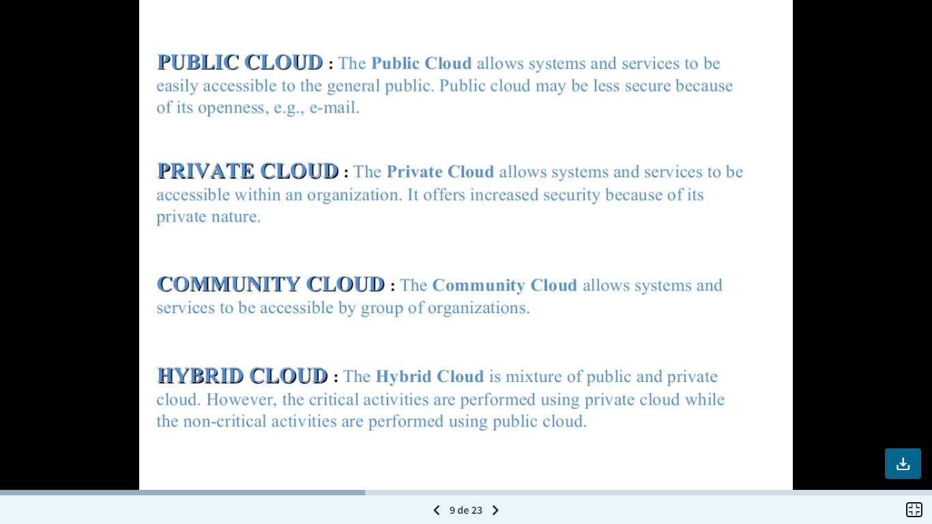

Slide 18
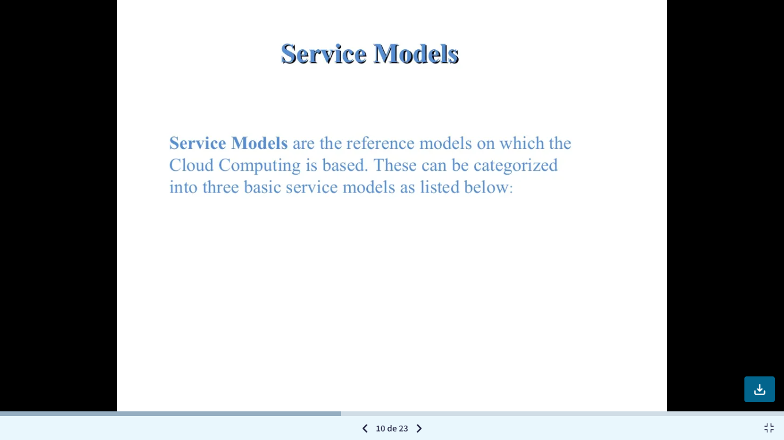

Slide 19
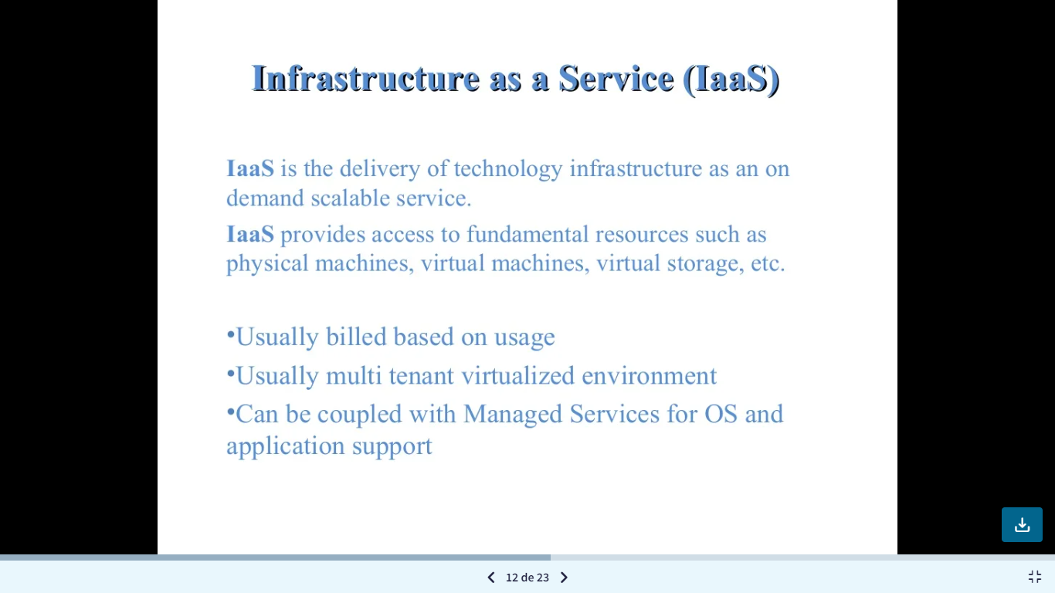

Slide 20
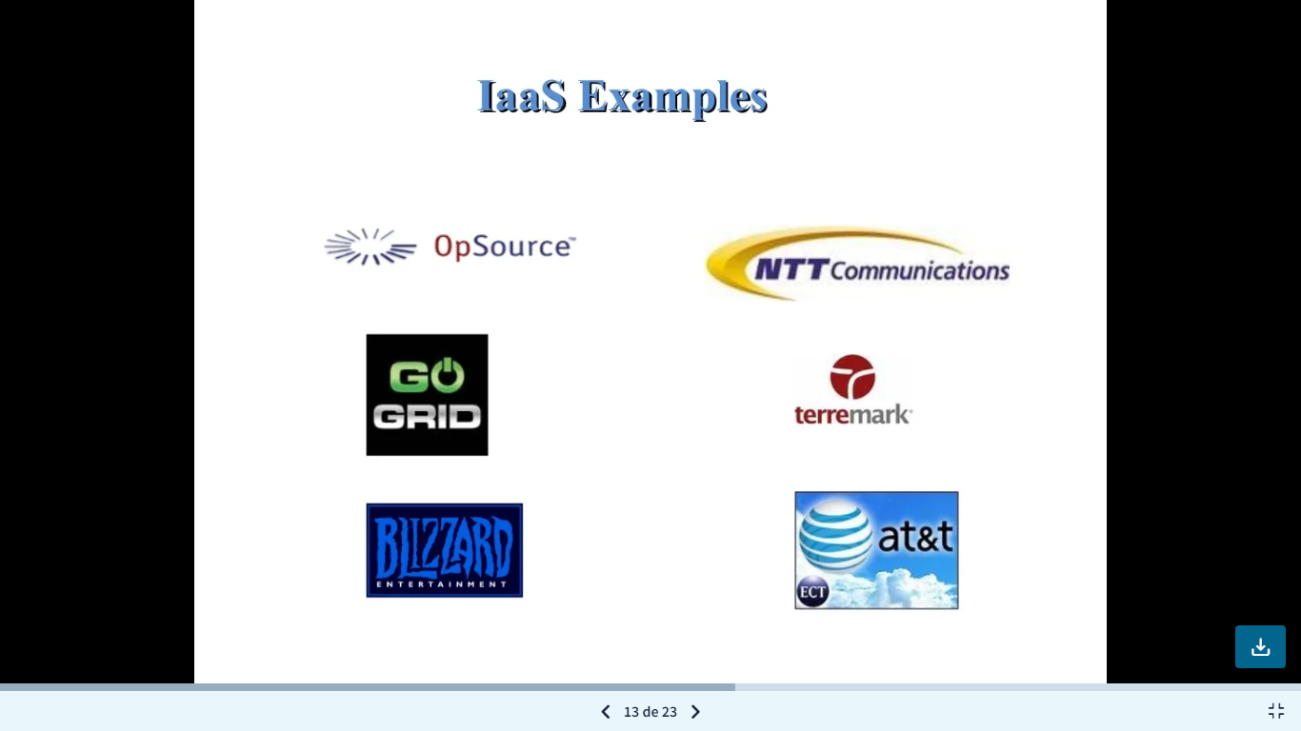

Slide 21
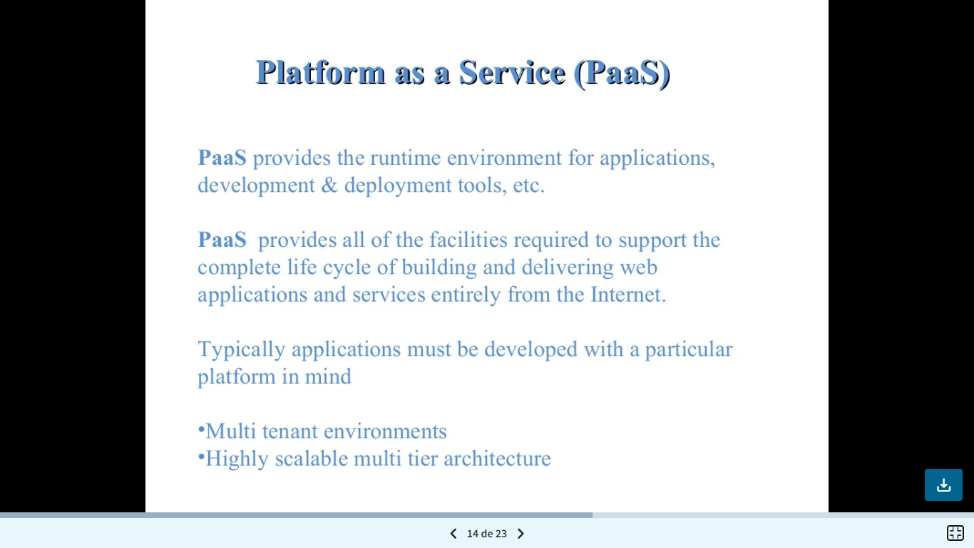

Slide 22
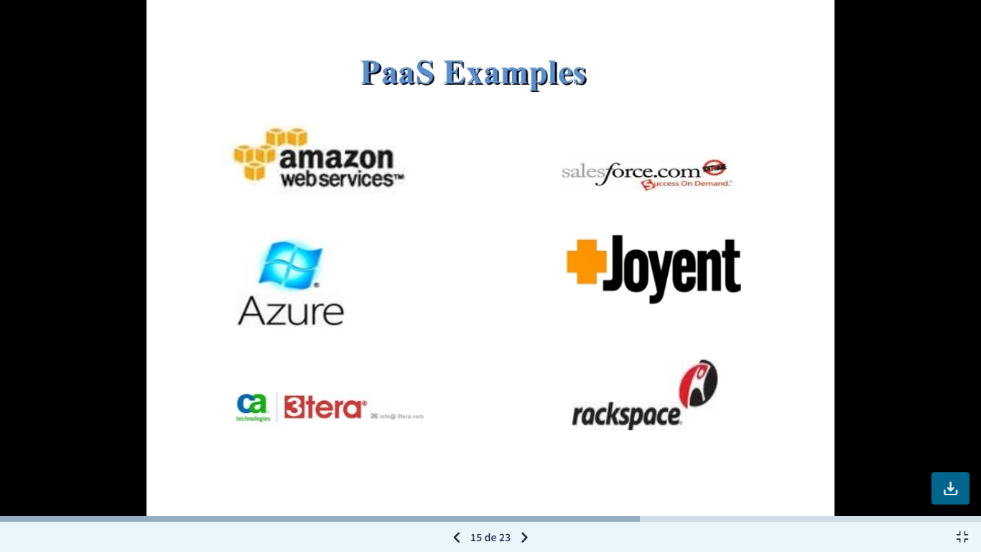

Slide 23
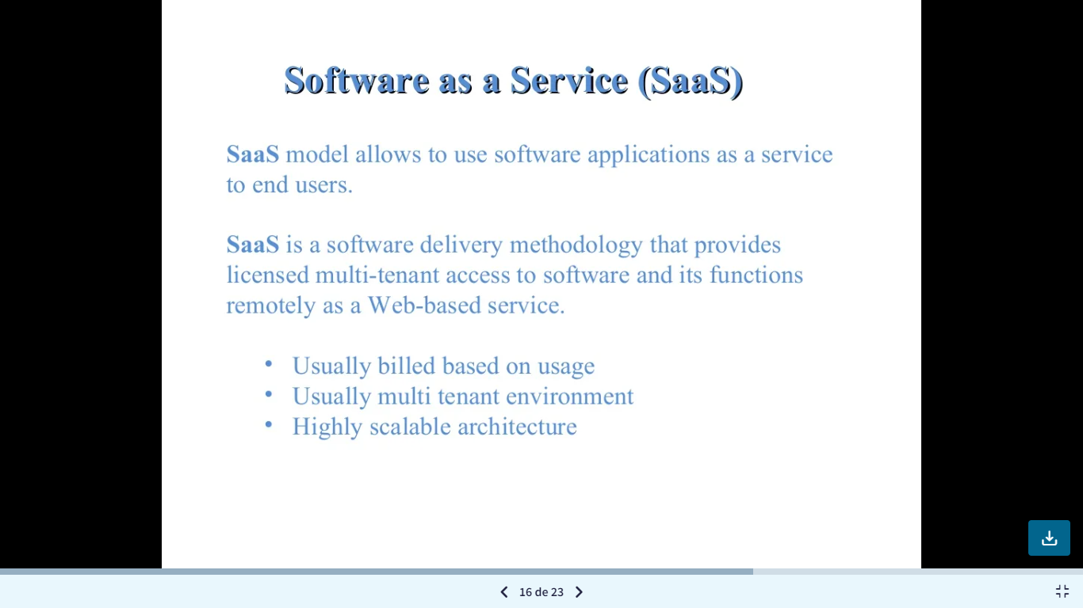

Slide 24
